Slide 1
Final Deliverable
By: Matt Chin, Sun Uk Kim, Drew Siedel, Robert Weber

Slide 2
Added Features:
Variable Rental Periods
Can set the number of days for each item to be rented
Credit Card
Can accept credit card payment as well as cash
Visible Running Total
As you add items, it displays the running total of how much you owe
Rental Deposits
Rentals now require an additional upfront deposit per item
Modified Rental Fee Rules
Returning rentals late now costs an extra fee

Slide 3
Bug Fixes:
Input Cleaning
Now checks to make sure inputs are valid before accepting them
More Efficient Tax Calculation
Tax is calculated cleaner, so less errors are less likely
More Efficient Date Calculation
Uses Calendar rather than Date so errors are less likely
Added Security
Added security on credit card verification and prevented code from being manipulated

Slide 4

Lessons Learned:
Never use Date in java, also avoid using Calendar if at all possible as it sucks
The more times you “fix” code the worse it gets
How to be salty

Slide 5
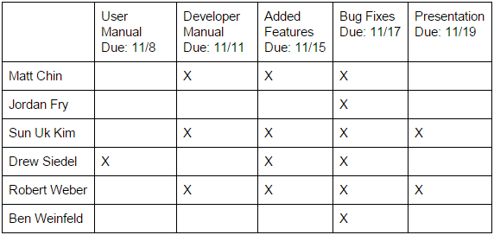
Resource Management

Slide 6
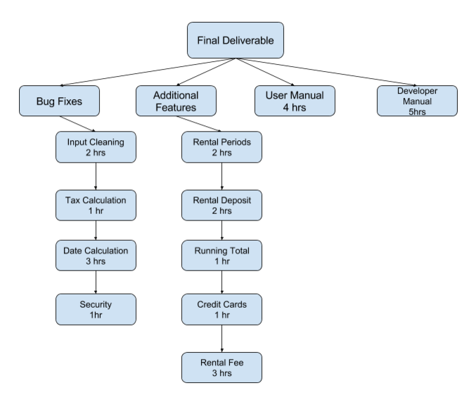
Work Breakdown Structure

Slide 7
Thank You;

